Slide 1
REST
By
Jitesh Suthar
Mohini Memane

Slide 2

Evolution of Enterprise Application Architecture
Monolithic Application Architecture (70´s)
Client – Server Architecture (90’s)
Web Based Architecture (2k)
Service Oriented Architecture (Present)

Slide 3
Service-Oriented Architecture (SOA)
Is an architectural approach to designing applications around a collection of independent services. A service can be any business functionality that completes an action and provides a specific result,
Loosely coupled
Is a “black box” to consumers of the service

Slide 4
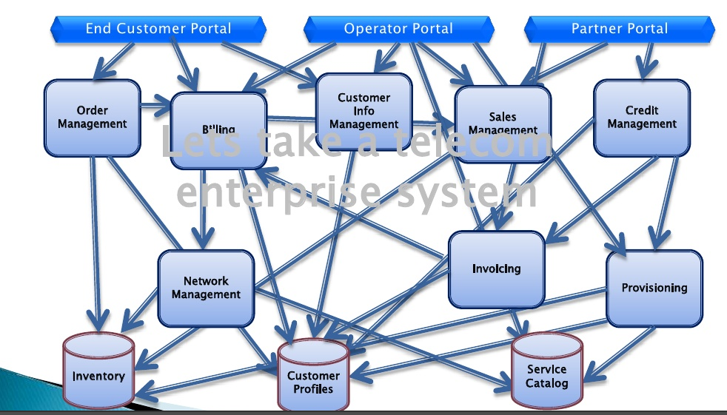
Why SOA ???

Slide 5
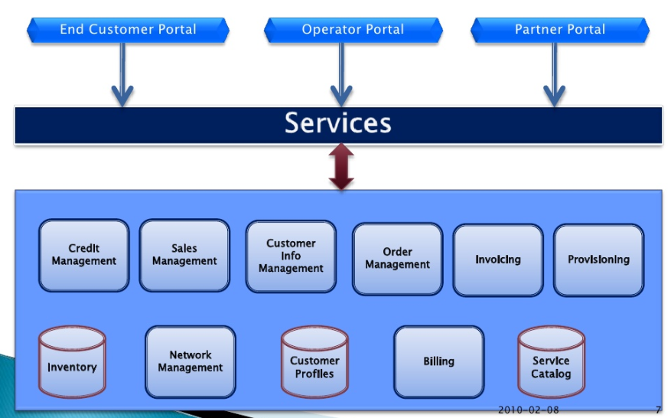
Why SOA ???

Slide 6
Web Service
Today , companies rely on thousands of different software applications each with their own role to play in running a business .These different software applications run on wide range of different platforms and operating systems,and they are implemented in different programming languages . As a result, it is very difficult for different applications to communicate with each other and share their resources in a coordinated way.
A Web Service is a network accessible interface to application functionality ,built using standard Internet protocols

Slide 7
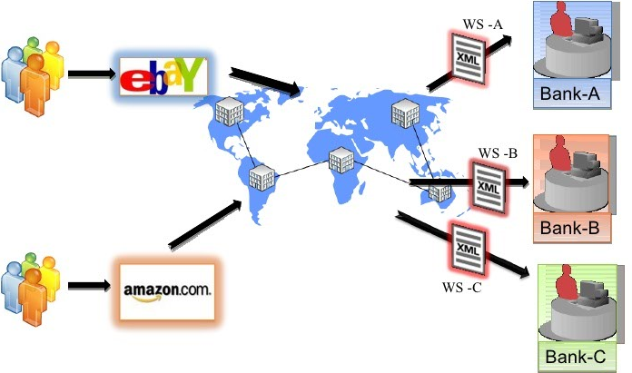
Web Service - Example

Slide 8


Web Service Implementation
SOAP
REST

Slide 9
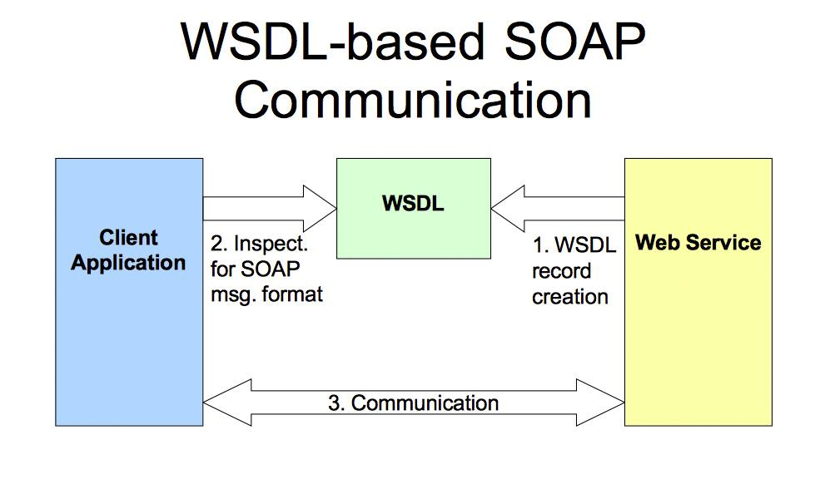
SOAP (Simple Object Access Protocol)
WSDL is a standard document which tells us what the web-service does

Slide 10
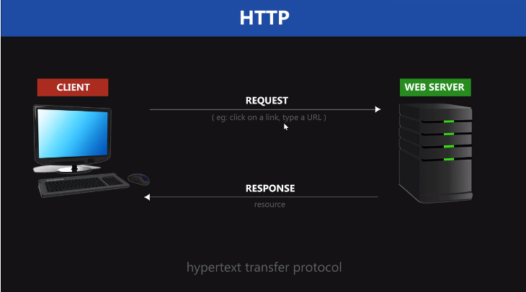
REST (Representational State Transfer)

Slide 11
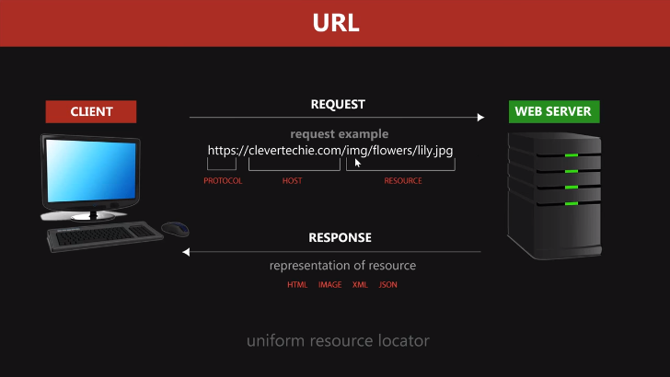
REST (Representational State Transfer)

Slide 12
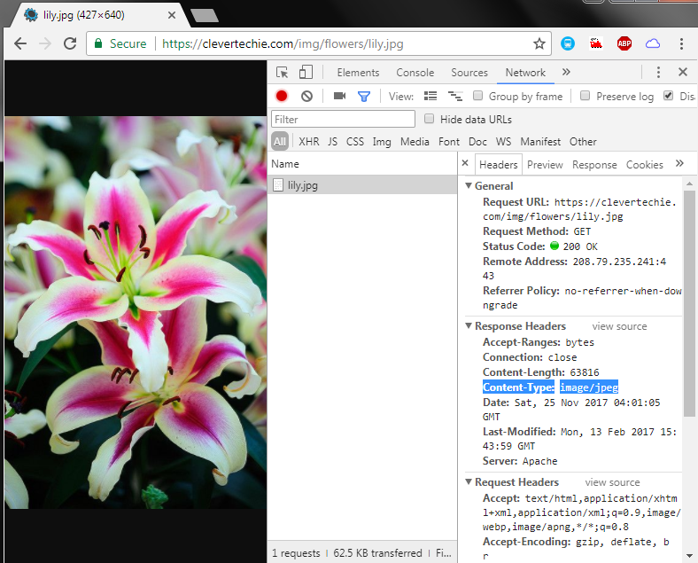
https://clevertechie.com/img/flowers/lily.jpg

Slide 13
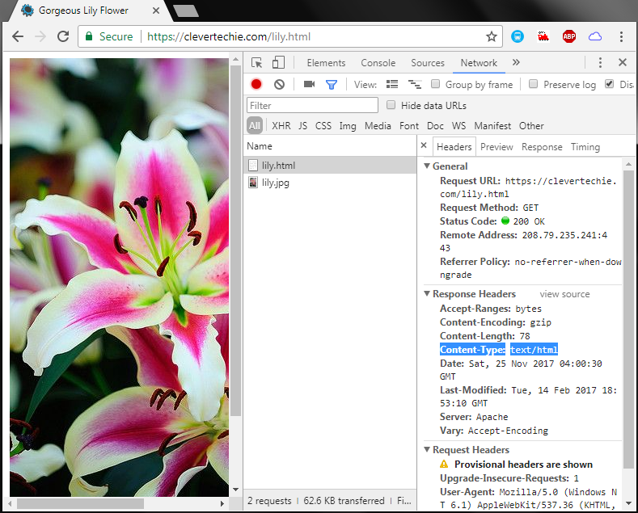
https://clevertechie.com/lily.html

Slide 14
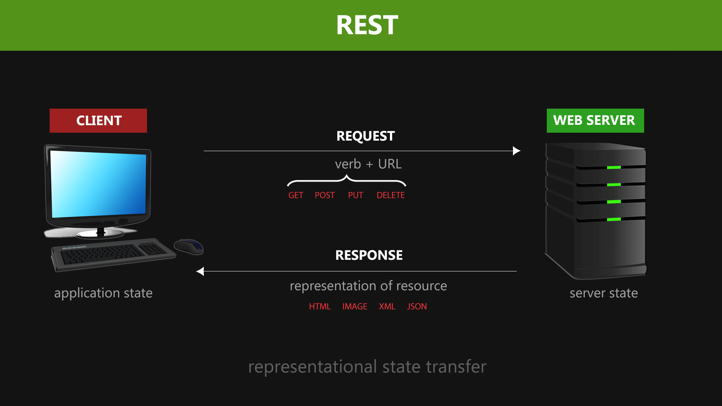
REST (Representational State Transfer)

Slide 15
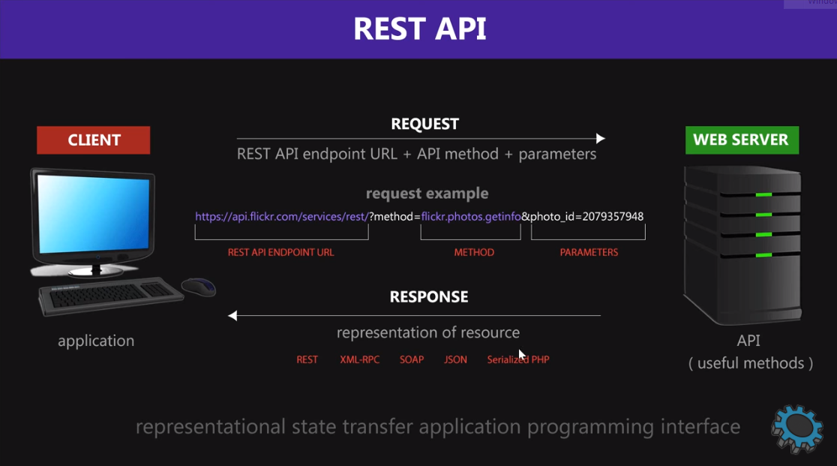
REST (Representational State Transfer)

Slide 16
REST (Representational State Transfer)
Communication between Client-Server in JSON, XML, TEXT or any other format. No protocol for response format.
Stateless
Any HTTP method like GET, POST, PUT, DELETE etc.
No Service Definition required.

Slide 17
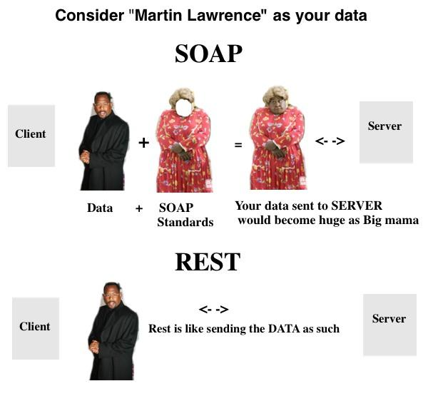
SOAP vs REST

Slide 18
LET’S GIVE IT A TRY! - REST using NODEJS
https://github.com/jiteshsuthar/restapi
\\lenovo15\shared

Slide 19
REST Configuration in our Application
Create a folder - REST/<modulename>
Create a file <servicename>.js in REST/<modulename>/
Define a service in REST/<modulename>/<servicename>.js.
iServiceManager.<servicename> = function() {
return {
_create: function(request,response,userObj) {/*code to insert the data*/},
_update: function(request,response,userObj) {/*code to update the data*/},
_read: function(request,response,userObj) { /*code to read the data*/},
_delete: function(request,response,userObj) {/*code to delete the data*/}
}
}
Registering the service
iServiceManager.loadService(“<service name>",“<path till the service folder>");

Slide 20
Try apigee.com/console
Check on projector screen

Slide 21


Slide 22

Break Time …..

